Slide 1
Applies Data Structure and Application
Dr Sachin K Saxena Sr Data Analyst, Portugal, MNC
Ex-Sr Software Engineer - Data Scientist

Slide 3
Content
Application of Stack: Conversion of Infix to Prefix Expressions
Application of Stack: Conversion of Infix to Postfix Expressions
Evaluation of Postfix Expression using Stack

Slide 4
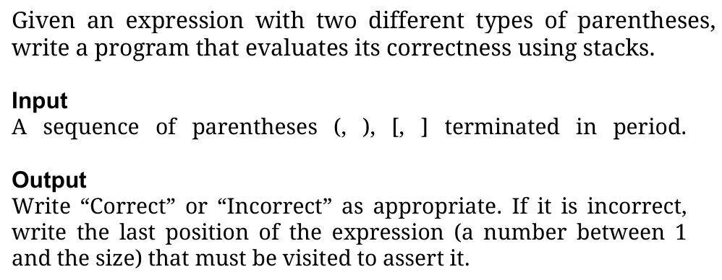
Stack: Parentheses Match

Slide 5
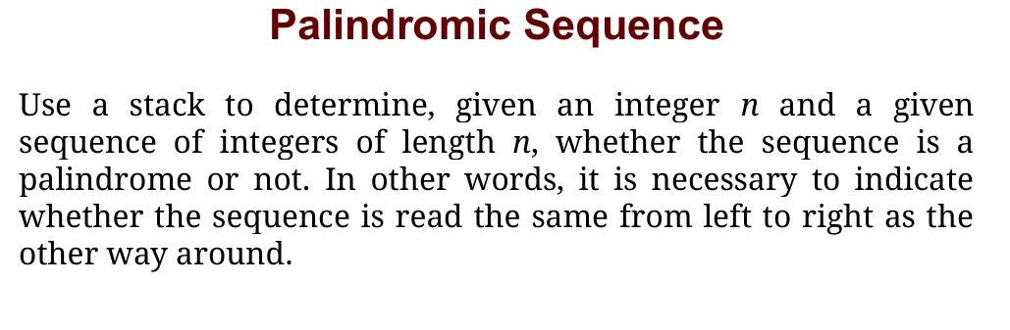
Stack

Slide 6
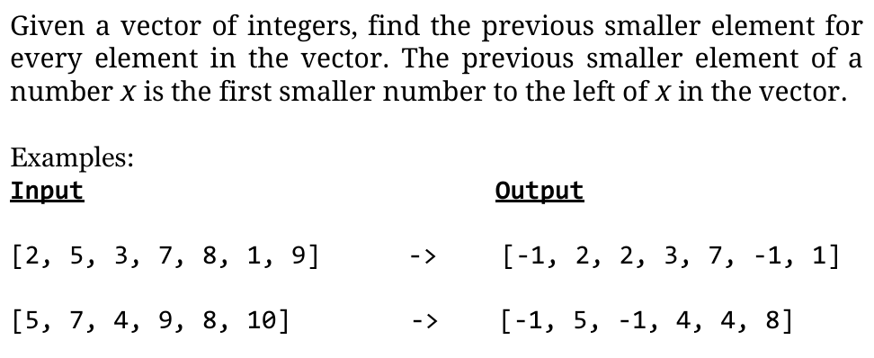
Stack
● A Stack is a linear data structure that only allows inserting, deleting and querying elements at one of its ends, which we call the top.
● LIFO type structure (Last In, First Out), in which the last element that enters is the first element that leaves.

Slide 7
Alternatives for Coding Practice and Interview Prep
● Leetcode: LeetCode - The World's Leading Online Programming Learning Platform
● Hackerrank: HackerRank
● Agoacademy: https://algocademy.com/blog/top-leetcode-alternatives-for-coding-practice/
● Datacamp: Learn Data Science and AI Online | DataCamp

Slide 8
Application of Stack: Conversion of Infix to Prefix Expressions
Infix: Operand Operator Operand eg: a+b
Infix: Operator Operand Operand eg: +ab
Infix: Operand Operand Operator eg: ab+

Slide 9
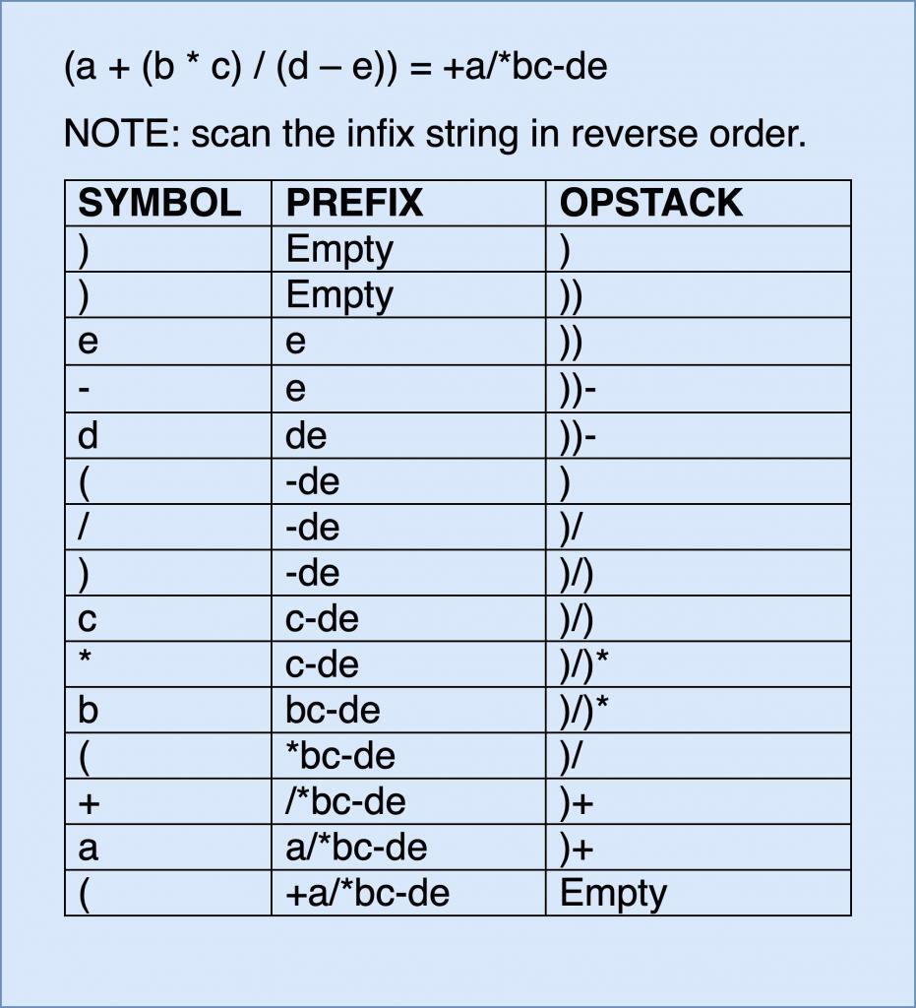
Application of Stack: Conversion of Infix to Prefix Expressions

Slide 10
Application of Stack: Conversion of Infix to Prefix Expressions

Slide 11
Application of Stack: Conversion of Infix to Postfix Expressions
Infix: Operand Operator Operand eg: a+b
Infix: Operator Operand Operand eg: +ab
Infix: Operand Operand Operator eg: ab+

Slide 12
Application of Stack: Conversion of Infix to Postfix Expressions
Let's solve : 8 + 3 * (9 - 6) / 2 pow 2 + 6 / 2
Answer:

Slide 13
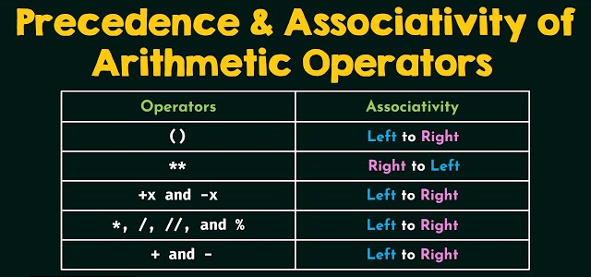
Application of Stack: Conversion of Infix to Postfix Expressions
Let's solve : 8 + 3 * (9 - 6) / 2 pow 2 + 6 / 2
Answer:

Slide 14
Application of Stack: Conversion of Infix to Postfix Expressions
Let's solve : 2 ^ 3 ^ 2
Answer: 64 or 512
(correct answer : 512)

Slide 15
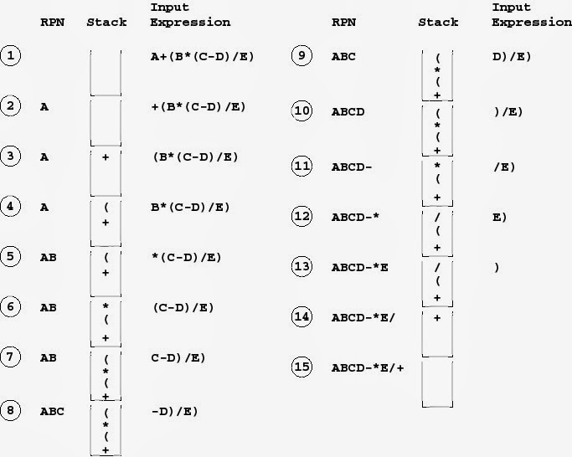
Application of Stack: Conversion of Infix to Postfix Expressions: Method 1

Slide 16
Application of Stack: Conversion of Infix to Postfix Expressions: Method 1

Slide 17
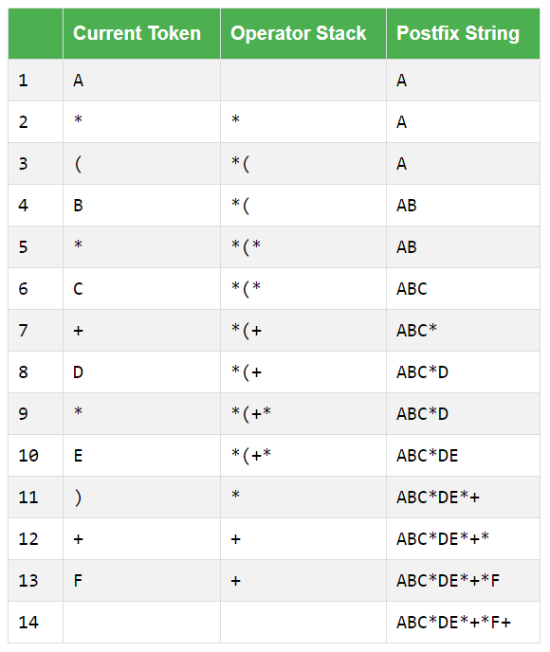
Application of Stack: Conversion of Infix to Postfix Expressions : Method 2
A*(B*C+D*E)+F

Slide 18
Application of Stack: Conversion of Infix to Postfix Expressions : Method 2
A*(B*C+D*E)+F

Slide 19
Application of Stack: Conversion of Infix to Postfix Expressions
The following postfix expression with single digit operands in evaluated using a stack
8 2 3 ^ / 2 3* + 5 1*-
Note that ^ is the exponentiation operator. The top two elements of the stack after the first * is evaluated are

Slide 20
Application of Stack: Conversion of Infix to Postfix Expressions
The following postfix expression with single digit operands in evaluated using a stack
9 + 3 – 2 * 2 % 3 + 1
Note that ^ is the exponentiation operator. The top two elements of the stack after the first * is evaluated are

Slide 21
Application of Stack: Conversion of Infix to Postfix Expressions
The following postfix expression with single digit operands in evaluated using a stack
8 2 3 ^ / 2 3* + 5 1*-
Note that ^ is the exponentiation operator. The top two elements of the stack after the first * is evaluated are
Answer: 6, 1

Slide 22
Application of Stack: Conversion of Infix to Postfix Expressions
The following infix expression with single digit operands in evaluated using a stack
9 + 3 – 2 * 2 % 3 + 1
What would be the stack value after the evaluation done:

Slide 23
Application of Stack: Conversion of Infix to Postfix Expressions
The following postfix expression with single digit operands in evaluated using a stack
9 + 3 – 2 * 2 % 3 + 1
What would be the stack value after the evaluation done:
Answer: 12

Slide 24
Thanking you !!!!
Any question !!!!!
Download PPT : https://github.com/sachin365123/Applies-Data-Structure-and-Application-GLA-Online-Sessions-Jan---Jun-2026

